Slide 1
How many solutions?
Hung-yi Lee
Notes:
New Question:
Why Homogeneous name homogeneous? Does it have applications?
Extension:
intuitive definition to another definition => should I proof it?
Why only one or infinite solution?
Intuitive link of infinite solution and independent
Question:
Example for 冗員
the correct definition of rank
dependent is defined on a set or a vector? On set

Slide 2
Reference
Textbook: Chapter 1.7

Slide 3






Review
Given a system of linear equations with m equations and n variables
$$A:m×n$$
$$x∈R^{n}$$
$$b∈R^{m}$$
Is $b$ a linear combination of columns of $A$?
Is $b$ in the span of the columns of $A$?
NO
YES
No solution
Have solution
How many solutions?
Notes:
Check existence first
One or infinite soluiton

Slide 4



Today
Given a system of linear equations with m equations and n variables
$$A:m×n$$
$$x∈R^{n}$$
$$b∈R^{m}$$
Is $b$ a linear combination of columns of $A$?
Is $b$ in the span of the columns of $A$?
NO
YES
The columns of $A$ are independent.
The columns of $A$ are dependent.
No solution
Rank A = n
Rank A < n
Other cases?
Nullity A = 0
Nullity A > 0
Unique solution
Infinite solution
Notes:
Check existence first
One or infinite soluiton

Slide 5
Notes:
如果有了一个以上的解，就会有无数解

Slide 6
Dependent and Independent
(依賴的、不獨立的)
(獨立的、自主的)

Slide 7
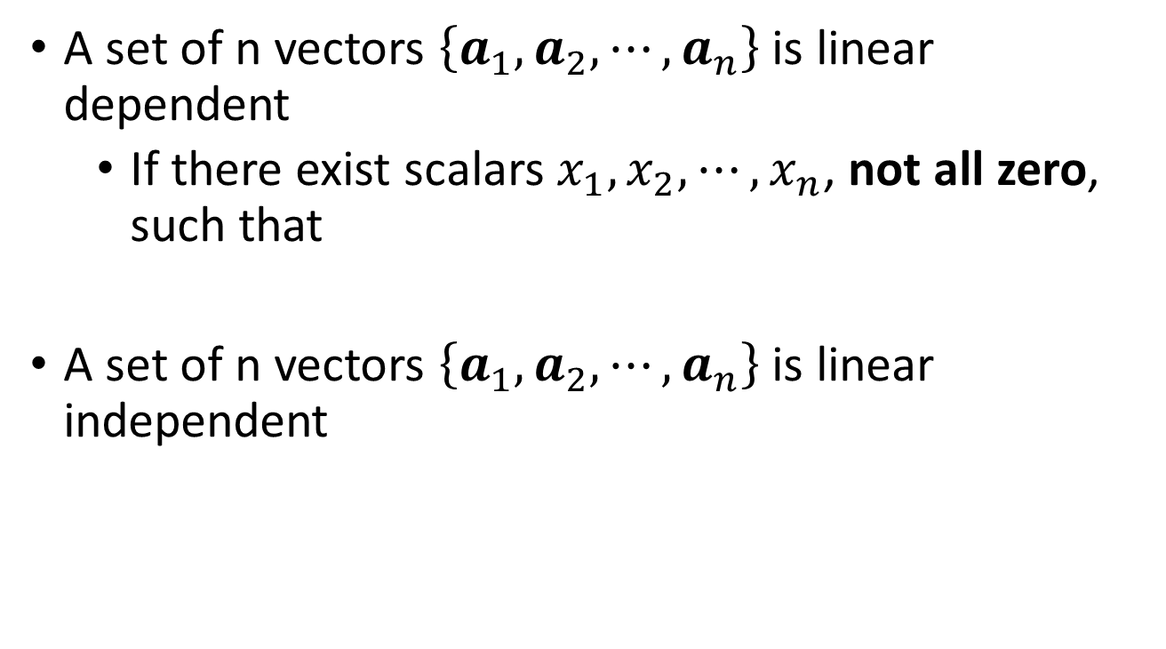
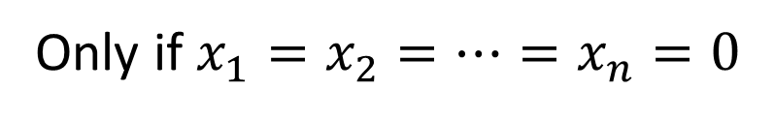
Definition
A set of n vectors $\left\{a_{1},a_{2},⋯,a_{n}\right\}$ is linear dependent
If there exist scalars $x_{1},x_{2},⋯,x_{n}$, not all zero, such that
A set of n vectors $\left\{a_{1},a_{2},⋯,a_{n}\right\}$ is linear independent
Find one
Obtain many
$$x_{1}a_{1}+x_{2}a_{2}+⋯+x_{n}a_{n}=0$$
$$x_{1}a_{1}+x_{2}a_{2}+⋯+x_{n}a_{n}=0$$
Only if $x_{1}=x_{2}=⋯=x_{n}=0$
unique
Notes:
How about the vector with only one element?
not all zero：存在一个冗余的（没有用的/可以被另一个替代或者等于0向量）vector
all zero：每一个vector都存在独特的信息，所以如果不都是0的话，就会等于0

Slide 8


Dependent and Independent
Linear Dependent
Given a vector set, {a₁, a₂, …, a_{n}}, if there exists any a_{i} that is a linear combination of other vectors
$$\left\{\begin{matrix}\left[\begin{matrix}−4 \\ 12 \\ 6\end{matrix}\right], & \left[\begin{matrix}−10 \\ 30 \\ 15\end{matrix}\right]\end{matrix}\right\}$$
Dependent or Independent?
$$\left\{\begin{matrix}\left[\begin{matrix}6 \\ 3 \\ 3\end{matrix}\right], & \left[\begin{matrix}1 \\ 8 \\ 3\end{matrix}\right], & \left[\begin{matrix}7 \\ 11 \\ 6\end{matrix}\right]\end{matrix}\right\}$$
Dependent or Independent?
Notes:
How about only one vector
2.5u₁ = u₂

Slide 9

Dependent and Independent
Linear Dependent
Given a vector set, {a₁, a₂, …, a_{n}}, if there exists any a_{i} that is a linear combination of other vectors
Dependent or Independent?
Zero vector is the linear combination of any other vectors
Any set contains zero vector would be linear dependent
How about a set with only one vector?
Notes:
$\left\{\left[\begin{matrix}0 \\ ⋮ \\ 0\end{matrix}\right]\right\}$ is linear dependent or independent? 不是，没有贡献的信息

Slide 10



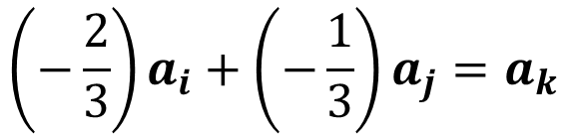

Dependent and Independent
Linear Dependent
Given a vector set, {a₁, a₂, …, a_{n}}, if there exists any a_{i} that is a linear combination of other vectors
$$2a_{i}+a_{j}+3a_{k}=0$$
$$2a_{i}+a_{j}=−3a_{k}$$
$$a_{i^{′}}=3a_{j^{′}}+4a_{k^{′}}$$
$$\left(−\frac{2}{3}\right)a_{i}+\left(−\frac{1}{3}\right)a_{j}=a_{k}$$
$$a_{i^{′}}−3a_{j^{′}}−4a_{k^{′}}=0$$
Given a vector set, {a₁, a₂, …, a_{n}}, there exists scalars x₁, x₂, …, x_{n}, that are not all zero, such that x₁a₁ + x₂a₂ + ☹ + x_{n}a_{n} = 0.
Notes:
有一个vector的信息是可以被其他的替代的
How to check?
Simple, check whether a vector is the linear combination of the other.
Are there better approach.
Draw on the black board……

Slide 11
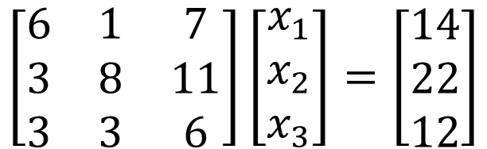


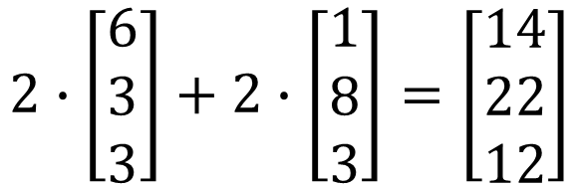
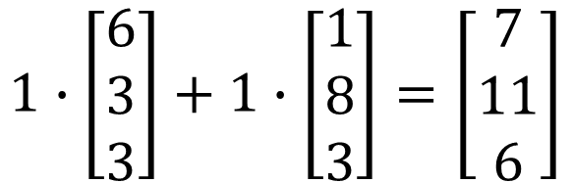
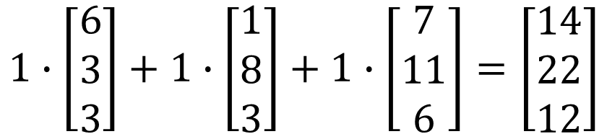
Intuition
Dependent:
Once we have solution, we have infinite.
Intuitive link between dependence and the number of solutions
$$\left[\begin{matrix}6 & 1 & 7 \\ 3 & 8 & 11 \\ 3 & 3 & 6\end{matrix}\right]\left[\begin{matrix}x_{1} \\ x_{2} \\ x_{3}\end{matrix}\right]=\left[\begin{matrix}14 \\ 22 \\ 12\end{matrix}\right]$$
$$1∙\left[\begin{matrix}6 \\ 3 \\ 3\end{matrix}\right]+1∙\left[\begin{matrix}1 \\ 8 \\ 3\end{matrix}\right]=\left[\begin{matrix}7 \\ 11 \\ 6\end{matrix}\right]$$
$$1∙\left[\begin{matrix}6 \\ 3 \\ 3\end{matrix}\right]+1∙\left[\begin{matrix}1 \\ 8 \\ 3\end{matrix}\right]+1∙\left[\begin{matrix}7 \\ 11 \\ 6\end{matrix}\right]=\left[\begin{matrix}14 \\ 22 \\ 12\end{matrix}\right]$$
$$\left[\begin{matrix}x_{1} \\ x_{2} \\ x_{3}\end{matrix}\right]=\left[\begin{matrix}1 \\ 1 \\ 1\end{matrix}\right]$$
$$2∙\left[\begin{matrix}6 \\ 3 \\ 3\end{matrix}\right]+2∙\left[\begin{matrix}1 \\ 8 \\ 3\end{matrix}\right]=\left[\begin{matrix}14 \\ 22 \\ 12\end{matrix}\right]$$
$$\left[\begin{matrix}x_{1} \\ x_{2} \\ x_{3}\end{matrix}\right]=\left[\begin{matrix}2 \\ 2 \\ 0\end{matrix}\right]$$
Infinite Solution

Slide 12
Proof
Columns of A are dependent → If Ax=b have solution, it will have Infinite Solutions
If Ax=b have Infinite solutions → Columns of A are dependent

Slide 13
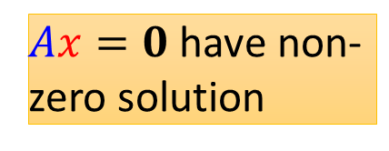
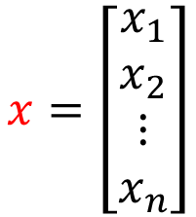
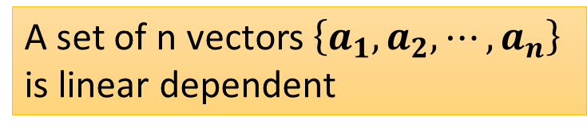
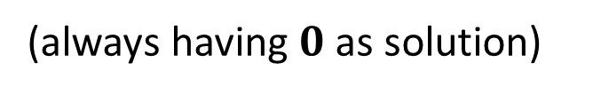

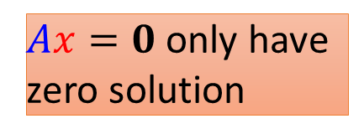

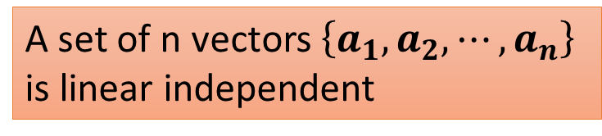
Proof
Homogeneous linear equations
$$x=\left[\begin{matrix}\begin{matrix}x_{1} \\ x_{2}\end{matrix} \\ \begin{matrix}⋮ \\ x_{n}\end{matrix}\end{matrix}\right]$$
$$Ax=0$$
$$A=\left[\begin{matrix}\begin{matrix}a_{1} & a_{2}\end{matrix} & \begin{matrix}⋯ & a_{n}\end{matrix}\end{matrix}\right]$$
(always having $0$ as solution)
Based on the definition
A set of n vectors $\left\{a_{1},a_{2},⋯,a_{n}\right\}$ is linear dependent
$Ax=0$ have non-zero solution
infinite
A set of n vectors $\left\{a_{1},a_{2},⋯,a_{n}\right\}$ is linear independent
$Ax=0$ only have zero solution
Notes:
同種的；同質的 Homogeneous
Homogeneous have more solutions
1. Does Ax = 0 always have a solution?
Linear independent => Only has one solution
Linear dependent => Exists non-zero solution

Slide 14

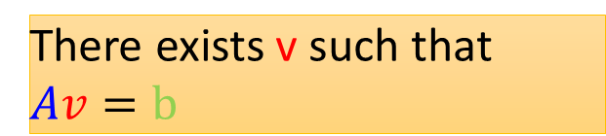

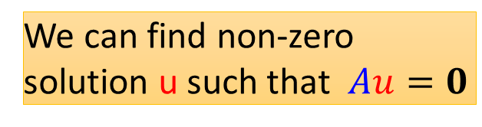

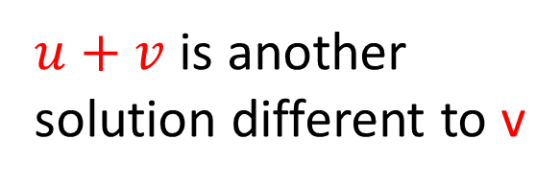


Proof
Columns of A are dependent → If Ax=b have solution, it will have Infinite solutions
If Ax=b have Infinite solutions → Columns of A are dependent
We can find non-zero solution u such that $Au=0$
$$A\left(u+v\right)=b$$
$u+v$ is another solution different to v
There exists v such that $Av=b$
$$Au=b$$
$$A\left(u−v\right)=0$$
$$u≠v$$
$$Av=b$$
Non-zero

Slide 15
Rank and Nullity

Slide 16



Rank and Nullity
The rank of a matrix is defined as the maximum number of linearly independent columns in the matrix.
Nullity = Number of columns - rank
$$\left[\begin{matrix}−3 & 2 & −1 \\ 7 & 9 & 0 \\ 0 & 0 & 2\end{matrix}\right]$$
$$\left[\begin{matrix}1 & 3 & 10 \\ 2 & 6 & 20 \\ 3 & 9 & 30\end{matrix}\right]$$
$$\left[\begin{matrix}0 & 0 & 0 \\ 0 & 0 & 0 \\ 0 & 0 & 0\end{matrix}\right]$$
Notes:
(b) the maximum number of linearly independent row vectors in the matrix. Both definitions are equivalent.
The rank of a matrix would be zero only if the matrix had no non-zero elements. If a matrix had even one non-zero element, its minimum rank would be one.

Slide 17




Rank and Nullity
The rank of a matrix is defined as the maximum number of linearly independent columns in the matrix.
Nullity = Number of columns - rank
$$\left[\begin{matrix}1 & 3 & 4 \\ 2 & 6 & 8\end{matrix}\right]$$
$$\left[\begin{matrix}0 & 3 \\ 0 & 5\end{matrix}\right]$$
$$\left[\begin{matrix}5 \\ 2\end{matrix}\right]$$
$$\left[6\right]$$
Notes:
(b) the maximum number of linearly independent row vectors in the matrix. Both definitions are equivalent.
The rank of a matrix would be zero only if the matrix had no non-zero elements. If a matrix had even one non-zero element, its minimum rank would be one.

Slide 18
Rank and Nullity
The rank of a matrix is defined as the maximum number of linearly independent columns in the matrix.
Nullity = Number of columns - rank
If A is a mxn matrix:
Rank A = n
Columns of A are independent
Nullity A = 0
Notes:
(b) the maximum number of linearly independent row vectors in the matrix. Both definitions are equivalent.
The rank of a matrix would be zero only if the matrix had no non-zero elements. If a matrix had even one non-zero element, its minimum rank would be one.

Slide 19



Conclusion
$$A:m×n$$
$$x∈R^{n}$$
$$b∈R^{m}$$
Is $b$ a linear combination of columns of $A$?
Is $b$ in the span of the columns of $A$?
NO
YES
The columns of $A$ are independent.
The columns of $A$ are dependent.
No solution
Rank A = n
Rank A < n
Nullity A = 0
Nullity A > 0
Unique solution
Infinite solution
Notes:
Check existence first
One or infinite soluiton

Slide 20





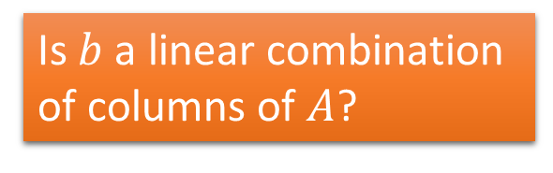


Conclusion
The columns of $A$ are independent.
$$A:m×n$$
Rank A = n
$$x∈R^{n}$$
$$b∈R^{m}$$
Nullity A = 0
NO
YES
Is $b$ a linear combination of columns of $A$?
Is $b$ a linear combination of columns of $A$?
Is $b$ in the span of the columns of $A$?
Is $b$ in the span of the columns of $A$?
NO
YES
NO
YES
No solution
Infinite
solution
No solution
Unique solution

Slide 21
Question
True or False
If the columns of A are linear independent, then Ax=b has unique solution.
If the columns of A are linear independent, then Ax=b has at most one solution.
If the columns of A are linear dependent, then Ax=b has infinite solution.
If the columns of A are linear independent, then Ax=0 (homogeneous equation) has unique solution.
If the columns of A are linear dependent, then Ax=0 (homogeneous equation) has infinite solution.
Notes:
No, may has no solution
Yes
No, may has no solution
Yes, all zero
Yes

